Slide 1

Partitioning

Slide 2
Cosmos DB Container (e.g. Collection)

Slide 3
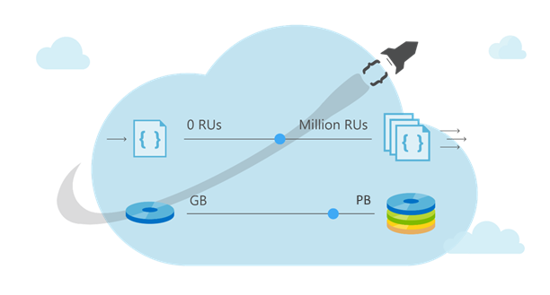
Cosmos DB Container (e.g. Collection)

Slide 4
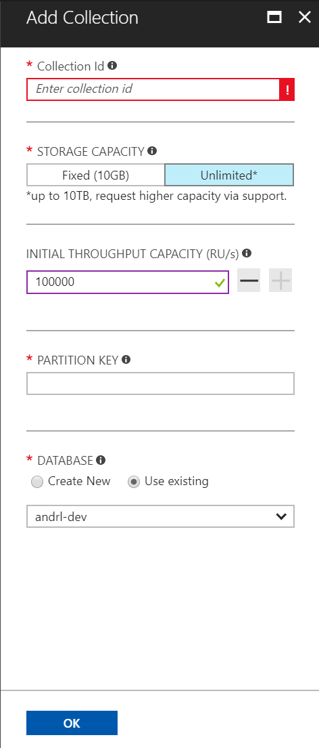
Cosmos DB Container (e.g. Collection)
Partitioning Scheme: top-most design decision in Cosmos DB

Slide 5
Cosmos DB Container (e.g. Collection)
Partition Key: User Id

Slide 6
Cosmos DB Container (e.g. Collection)
Partition Key: User Id
Logical Partitioning Abstraction
hash(User Id)
Behind the Scenes:
Physical Partition Sets
Psuedo-random distribution of data over
range of possible hashed values

Slide 7
Behind the Scenes:
Physical Partition Sets
hash(User Id)
….
Partition 1
Partition 2
Partition n
Frugal # of Partitions based on actual storage and throughput needs
(yielding scalability with low total cost of ownership)

Slide 8
Behind the Scenes:
Physical Partition Sets
hash(User Id)
….
Partition 1
Partition 2
Partition n
Frugal # of Partitions based on actual storage and throughput needs
(yielding scalability with low total cost of ownership)

Slide 9
Behind the Scenes:
Physical Partition Sets
hash(User Id)
Andrew
Dharma
Shireesh
Karthik
Rimma
Mike
Bob
….
Alice
Carol
…
…
Partition 1
Partition 2
Partition n
Frugal # of Partitions based on actual storage and throughput needs
(yielding scalability with low total cost of ownership)

Slide 10
Behind the Scenes:
Physical Partition Sets
hash(User Id)
Andrew
Dharma
Shireesh
Karthik
Rimma
Mike
Bob
….
Alice
Carol
…
…
Partition 1
Partition 2
Partition n
What happens when partitions need to grow?

Slide 11
Behind the Scenes:
Physical Partition Sets
hash(User Id)
Partition Ranges can be dynamically sub-divided
To seamlessly grow database as the application grows
While sedulously maintaining high availability
Dharma
Dharma
Rimma
Shireesh
Karthik
Rimma
+
Shireesh
Karthik
Alice
Carol
…
…
…
Partition X
Partition X1
Partition X2

Slide 12
Behind the Scenes:
Physical Partition Sets
hash(User Id)
Partition Ranges can be dynamically sub-divided
To seamlessly grow database as the application grows
While sedulously maintaining high availability
Best of All:
Partition management is completely taken care of by the system
You don’t have to lift a finger… the database takes care of you.
Dharma
Dharma
Rimma
Shireesh
Karthik
Rimma
+
Shireesh
Karthik
Alice
Carol
…
…
…
Partition X
Partition X1
Partition X2

Slide 13
Behind the Scenes:
Physical Partition Sets
hash(User Id)
[A-F]
[G-M]
[M-T]
[U-Z]
An easier way to think of consistent hashing is to project this range of hashed values as a ring.
[A-F]
[G-M]
[M-T]
[U-Z]

Slide 14
Behind the Scenes:
Physical Partition Sets
hash(User Id)
[A-F]
[G-M]
[M-T]
[U-W]
[X-Z]
An easier way to think of consistent hashing is to project this range of hashed values as a ring.
The database can elastically scale infinitely while maintaining high availability by minimizing data movement and subdividing partitions
[A-F]
[G-M]
[X-Z]
[M-T]
[U-W]

Slide 15
Cosmos DB Container (e.g. Collection)
Best Practices: Design Goals for Choosing a Good Partition Key
Distribute the overall request + storage volume
Avoid “hot” partition keys
Partition Key is scope for [efficient] queries and transactions
Queries can be intelligently routed via partition key
Omitting partition key on query requires fan-out

Slide 16
Cosmos DB Container (e.g. Collection)
Best Practices: Design Goals for Choosing a Good Partition Key
Distribute the overall request + storage volume
Avoid “hot” partition keys
Partition Key is scope for [efficient] queries and transactions
Queries can be intelligently routed via partition key
Omitting partition key on query requires fan-out
Steps for Success
Ballpark scale needs (size/throughput)
Understand the workload
# of reads/sec vs writes per sec
Use 80/20 rule to help optimize bulk of workload
For reads – understand top X queries (look for common filters)
For writes – understand transactional needs understand ratio of inserts vs updates

Slide 17
Cosmos DB Container (e.g. Collection)
Best Practices: Design Goals for Choosing a Good Partition Key
Distribute the overall request + storage volume
Avoid “hot” partition keys
Partition Key is scope for [efficient] queries and transactions
Queries can be intelligently routed via partition key
Omitting partition key on query requires fan-out
Steps for Success
Ballpark scale needs (size/throughput)
Understand the workload
# of reads/sec vs writes per sec
Use 80/20 rule to help optimize bulk of workload
For reads – understand top X queries (look for common filters)
For writes – understand transactional needs understand ratio of inserts vs updates
General Tips
Don’t be afraid of having too many partition keys
Partitions keys are logical
More partition keys => more scalability

Slide 18
Request Units

Slide 19
% CPU
Request Units
Request Units (RU) is a rate-based currency
Abstracts physical resources for performing requests
Key to providing isolation in a multi-tenant environment
Enables SLAs for predictable performance
Foreground and background activities
% Memory
% IOPS

Slide 20
GET
Request Units
Normalized across various access methods
1 RU = 1 read of 1 KB record
Each request consumes fixed RUs
Applies to reads, writes, queries, and stored procedure execution
POST
PUT
Query
…

Slide 21
Request Units
Provisioned in terms of RU/sec
Rate limiting based on amount of throughput provisioned
Can be increased or decreased instantaneously
Billing is metered hourly
Background processes like TTL expiration, index transformations scheduled when quiescent
Rate limit
Max RU/sec
No throttling
Incoming Requests
Min RU/sec
Replica
Quiescent

Slide 22
Pricing Example
Storage Cost
Avg Record Size (KB) | 1
Number of Records | 100,000,000
* pricing may vary by region; for up-to-date pricing, see: https://azure.microsoft.com/pricing/details/cosmos-db/

Slide 23
Pricing Example
Storage Cost
Avg Record Size (KB) | 1
Number of Records | 100,000,000
Total Storage (GB) | 100
Monthly Cost per GB | $0.25
* pricing may vary by region; for up-to-date pricing, see: https://azure.microsoft.com/pricing/details/cosmos-db/

Slide 24
Pricing Example
Storage Cost
Avg Record Size (KB) | 1
Number of Records | 100,000,000
Total Storage (GB) | 100
Monthly Cost per GB | $0.25
Expected Monthly Cost for Storage | $25.00
* pricing may vary by region; for up-to-date pricing, see: https://azure.microsoft.com/pricing/details/cosmos-db/

Slide 25
Pricing Example
Storage Cost
Avg Record Size (KB) | 1
Number of Records | 100,000,000
Total Storage (GB) | 100
Monthly Cost per GB | $0.25
Expected Monthly Cost for Storage | $25.00
Throughput Cost
Operation Type | Number of Requests per Second | Avg RU's per Request | RU's Needed
Create | 100 | 5 | 500
Read | 400 | 1 | 400
* pricing may vary by region; for up-to-date pricing, see: https://azure.microsoft.com/pricing/details/cosmos-db/

Slide 26
Pricing Example
Storage Cost
Avg Record Size (KB) | 1
Number of Records | 100,000,000
Total Storage (GB) | 100
Monthly Cost per GB | $0.25
Expected Monthly Cost for Storage | $25.00
Throughput Cost
Operation Type | Number of Requests per Second | Avg RU's per Request | RU's Needed
Create | 100 | 5 | 500
Read | 400 | 1 | 400
Total RU/sec | 900
Monthly Cost per 100 RU/sec | $6.00
* pricing may vary by region; for up-to-date pricing, see: https://azure.microsoft.com/pricing/details/cosmos-db/

Slide 27
Pricing Example
Storage Cost
Avg Record Size (KB) | 1
Number of Records | 100,000,000
Total Storage (GB) | 100
Monthly Cost per GB | $0.25
Expected Monthly Cost for Storage | $25.00
Throughput Cost
Operation Type | Number of Requests per Second | Avg RU's per Request | RU's Needed
Create | 100 | 5 | 500
Read | 400 | 1 | 400
Total RU/sec | 900
Monthly Cost per 100 RU/sec | $6.00
Expected Monthly Cost for Throughput | $54.00
* pricing may vary by region; for up-to-date pricing, see: https://azure.microsoft.com/pricing/details/cosmos-db/

Slide 28
Pricing Example
Storage Cost
Avg Record Size (KB) | 1
Number of Records | 100,000,000
Total Storage (GB) | 100
Monthly Cost per GB | $0.25
Expected Monthly Cost for Storage | $25.00
Throughput Cost
Operation Type | Number of Requests per Second | Avg RU's per Request | RU's Needed
Create | 100 | 5 | 500
Read | 400 | 1 | 400
Total RU/sec | 900
Monthly Cost per 100 RU/sec | $6.00
Expected Monthly Cost for Throughput | $54.00
Total Monthly Cost
[Total Monthly Cost] = [Monthly Cost for Storage] + [Monthly Cost for Throughput]
= $25 + $54
= $79 per month
* pricing may vary by region; for up-to-date pricing, see: https://azure.microsoft.com/pricing/details/cosmos-db/

